Slide 1
Module 7 Intercultural Business Protocol

Slide 2
Learning Objectives
understand the importance of appropriate business etiquette and social customs in intercultural communication
identify cultural differences in making introductions, making greetings and exchanging business card

Slide 3
Contents
Making Introductions
Exchanging business cards
Dining etiquette
Dressing
Social customs

Slide 4
Let’s see how much you know…… QUIZ TIME!

Slide 5
1. In Saudi Arabia, which is considered a popular gesture of friendship between men?
A. a high-five
B. holding hands while walking
C. a handshake
D. winking
E. a hug or kiss on the cheek

Slide 6
2. In Great Britain, tapping your nose indicates that something is:
A. confidential
B. smelly
C. inappropriate
D. very important
E. incredibly boring

Slide 7
3. Which of the following is/are associated with death and should not be given as gifts in the Chinese culture?
A. clocks
B. straw sandals
C. a handkerchief
D. all of the above
Notes:
中国人有不送手帕、伞、钟、剪刀的习俗。
忌送钟，因为『送钟』谐音『送终』，一定要送钟时，也要加送一本书，谐音『有始有终』；
忌送伞或送扇，因『伞』字、『扇』字与『散』字同音，有分手之意。也有「送扇，无相见」的说法。
忌送剪刀或菜刀，因为会引起『一刀两断』、「一剪两断」的联想。
忌送手巾是因为「送巾，断根」，「送巾，离恨」之说。这次因为旧时丧家常于丧事办完后送手巾给吊丧者，用意 在于让吊丧者与死者断绝来往。因此在通常的情况下，赠人手巾，就会令人想起不吉的丧事或永别的意思。

Slide 8
4. What is considered to be a generous tip in numerous situations like fine restaurants in western countries :
A. 15% tip
B. the more the better
C. 20% tip
D. no tip at all
E. 50% tip

Slide 9
5. When doing business in Iran, a woman should cover their:
A. Mouth
B. Feet
C. Eyes
D. Arms and Legs
E. Arms, Legs and Hair

Slide 10
Making Introductions

Slide 11
Role-play：
Hongyun company is an agency of the Lenovo computer company. Now Mr. Wang, the Business representative and the manager, Miss Li are meeting Mr.Zhang ,the manager of Lenovo computer company in North China district to talk about business matters. Mr. Wang had business contacts with Mr.Zhang before, but it is the first time for Miss Li to meet Mr.Zhang .
Please make a role-play .

Slide 12
Qs:
What rules should be abide by when making introduction？
How to respond properly to the introduction?
What should be paid attention to when shaking hands?

Slide 13
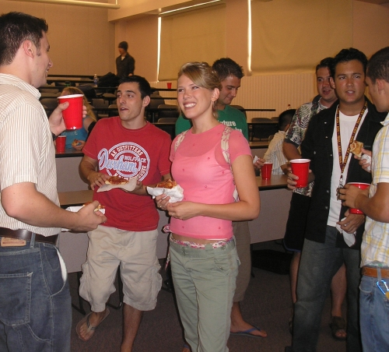
The proper introduction can be a good beginning for the future communication.
United States ,Great Britain ：
First names are used usually, but do not use first names in business introductions
Germany, Italy ,Chinese:
Titles are used when introducing

Slide 14
Some guidelines for introduction
Sequence of Introducing
woman
Superior
old
Colleague
domestic colleagues
guest
inferior
foreign colleagues
official
non-official
man
Young

Slide 15
Sequence of Introducing
Man
Woman
Young
old
inferior
Superior
Nonofficial
official
Colleague
Guest
Domestic colleagues
Foreign colleagues
Position-age-sex

Slide 16
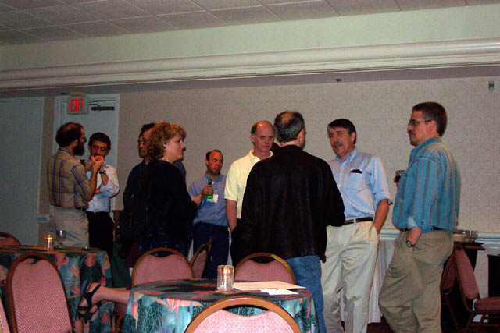
However, in business introductions, there is one basic rule:
a less important person is introduced to a more important person, whether male or female.

Slide 17
The Response to the Introduction
Once you are introduced, you’ll attract other's attention. Now, you should respond properly.
Remember the following tips:

Slide 18
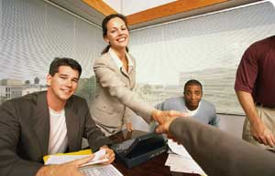
Stand up.
If you cannot stand up, you should show your intention to do so, or try your best to stand up. No matter you are lady or gentleman, you should follow this rule.

Slide 19
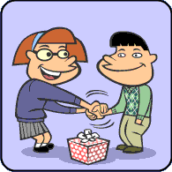
2) Approach and look at the other person with a smile to show respect to the other party.

Slide 20
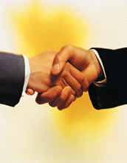
3) Shake hands.
Shaking hands is to show your trust and respect, and it's also a way to send your greetings.

Slide 21
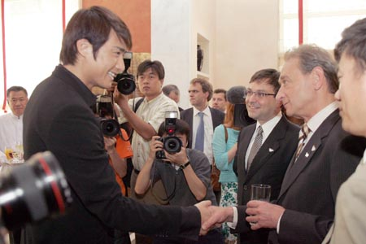
Hand-shaking codes
Your hand-shake should be relaxed but firm (never limp), and you should look at the other person in the eyes, smile, and say “I am very pleased to meet you." or give other cordial greetings.
Do not hold on to the other person's hand or pump his or her arm.
Notes:
When you are introduced to someone, either one of you may extend your hand first. Your hand-shake should be relaxed but firm (never limp), and you should look at the other person in the eyes, smile, and say “I am very pleased to meet you." or give other cordial greetings.

Slide 22
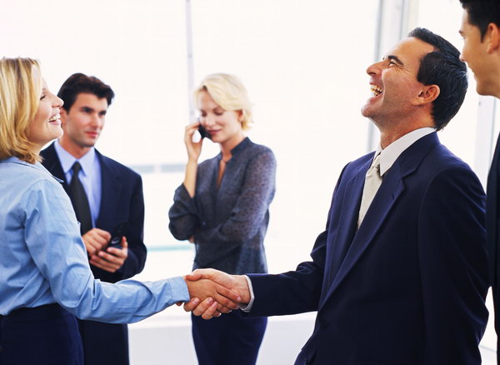
What would you do?
If someone you are meeting seems to back off:
do not force a handshake.
If he does not respond to your offer to shake hands:
simply drop your hand back to your side, smile, and say "Hello.”

Slide 23
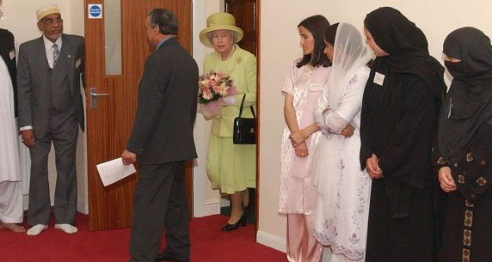
For men, the rules are different when greeting an Islamic female. Rule number one is never greet a woman with a kiss.
Also, you should never offer your hand to a woman first.

Slide 24
握手
Cross handshake
No eye contact
Wearing gloves
Swing hands

Slide 25
Exchanging Business Cards

Slide 26
Group work:
Discuss with the group members and make a list of the rules when exchanging business cards.

Slide 27
The rules of the card game
Always present your card with the printed side up or, in the case of bilingual cards, with the local language side showing.
Presenting your business card after being introduced.
Presenting a card with two hands conveys respect。
Likewise, you should receive a business card with both hands.

Slide 28
The rules of the card game
5) It's not only polite to have your card translated into the local language it is now considered a must. Make it work for you.
6) Take plenty of cards. It can be highly embarrassing to run out of them.
7) Treat the card with respect.

Slide 29
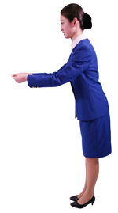
Treat the card with respect
Once you have it in hand, take time to read it.
In many Asian cultures it is insulting to put the card directly in your pocket, wallet or card case without giving it sufficient study time.
3) You may write on your own card, it is considered rude and disrespectful to write on someone else’ s.
4) In Japan it is best to lay the card in front of you on the table, especially during the first meeting.
5)while presenting or receiving a business card, use the right hand.

Slide 30
Practice：
Li Hua, the manager of Purchasing department of Tongda Company, makes a visit to the Lenovo Inc. He wants to order a number of new products. Wang Mei, the Secretary, introduces him to the manager of the product development department Mr. Lin.
Please act as the roles to make introduction and exchange business cards.

Slide 31
Dining etiquette

Slide 32
Group Work:
What behaviors are considered as bad manners in Chinese dining practices?

Slide 33
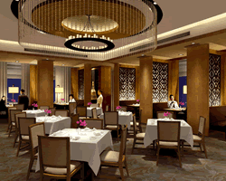
1.Chinese Dining Practices
It is considered rude to wave your chopsticks around as you decide which dish to sample next.
2) Never stick your chopsticks into food and let them stand upright.
3) It is bad manners to use chopsticks like a fork to spear your food with the tips.
4) Avoid pulling or dragging dishes toward you with your chopsticks.

Slide 34
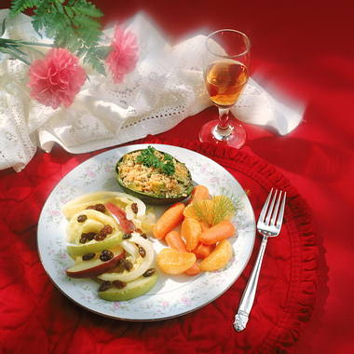
2.Western Dining Practices

Slide 35
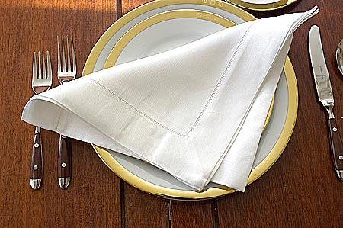
Eating in Public: 6 questions
Question 1
You excuse yourself to use the restroom. Where do you place your napkin?
On the floor
Folded on the table
On your chair
Take it with you

Slide 36
Question 2
You have finished eating your meal. How do you let the waiter know?
Yell at him.
Mash your napkin on your plate so you won’t eat anymore.
Push your plate(s) away from you.
Place your utensils at 10:20 (10 and 4).

Slide 37
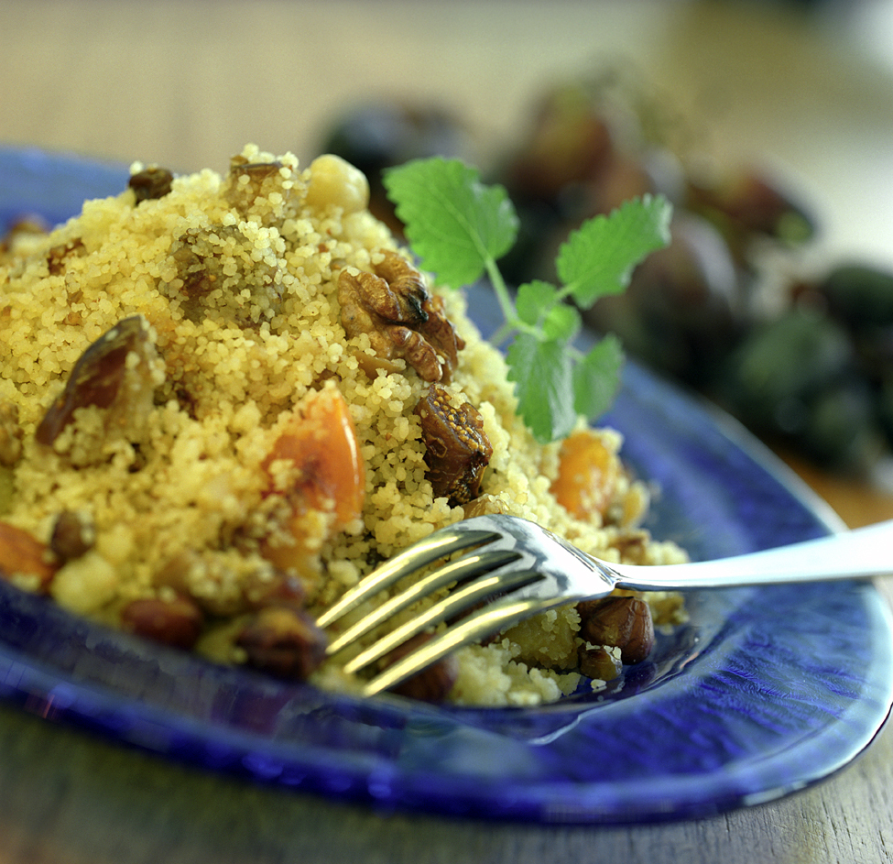
Question 3
When you are dining in a restaurant and you accidentally drop your fork on the floor, you:
Pick it up, wipe it off, and use it anyway
Pick it up, give it to the server, and ask him to bring you another one
Leave it on the floor and ask the server to bring you another one
d) Leave it on the floor and use your neighbor’s fork when he’s not looking

Slide 38
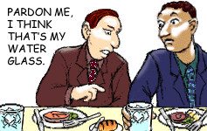
Question 4
When seated at a round or rectangular table:
Remember, left to right, B-M-W: bread, meal, water
Remember left to right, D-D-R: drink, dinner plate, roll
It doesn’t matter. There’s enough water and bread to go around anyway.

Slide 39
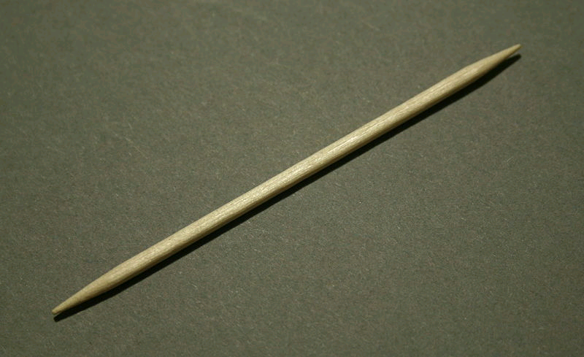
Question 5
If you have a small piece of food lodged in your teeth and you want to remove it, you:
Take your knife when no one is looking and remove the morsel(碎屑) promptly with the blade
Raise your napkin to your mouth and discreetly use a sugar packet or your business card to remove the morsel
c) Politely ask your server for a toothpick
d) Excuse yourself and go to the restroom to pick your teeth in private

Slide 40
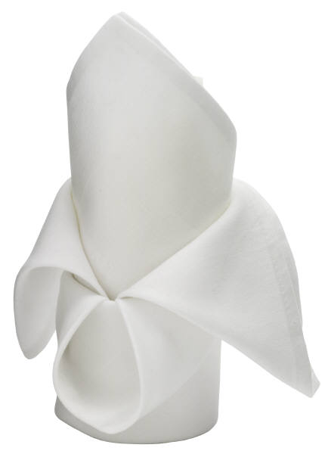
Question 6
When you are finished eating, your napkin should be
a) Folded loosely and placed on the right side of your plate
b) Folded loosely and placed on the left side of your plate
Folded loosely and placed on the center of your plate
d) Folded like a dove or pirate’s hat and placed in the center of your chair

Slide 41
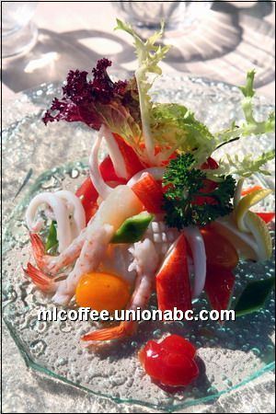
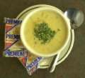
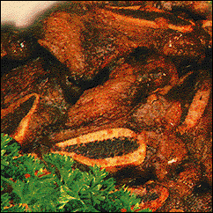
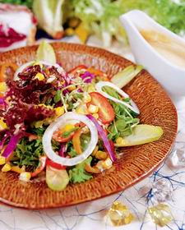
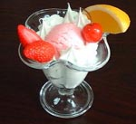
Dishes Serving
starter
1
soup
2
main course
3
salad
4
dessert
5

Slide 42
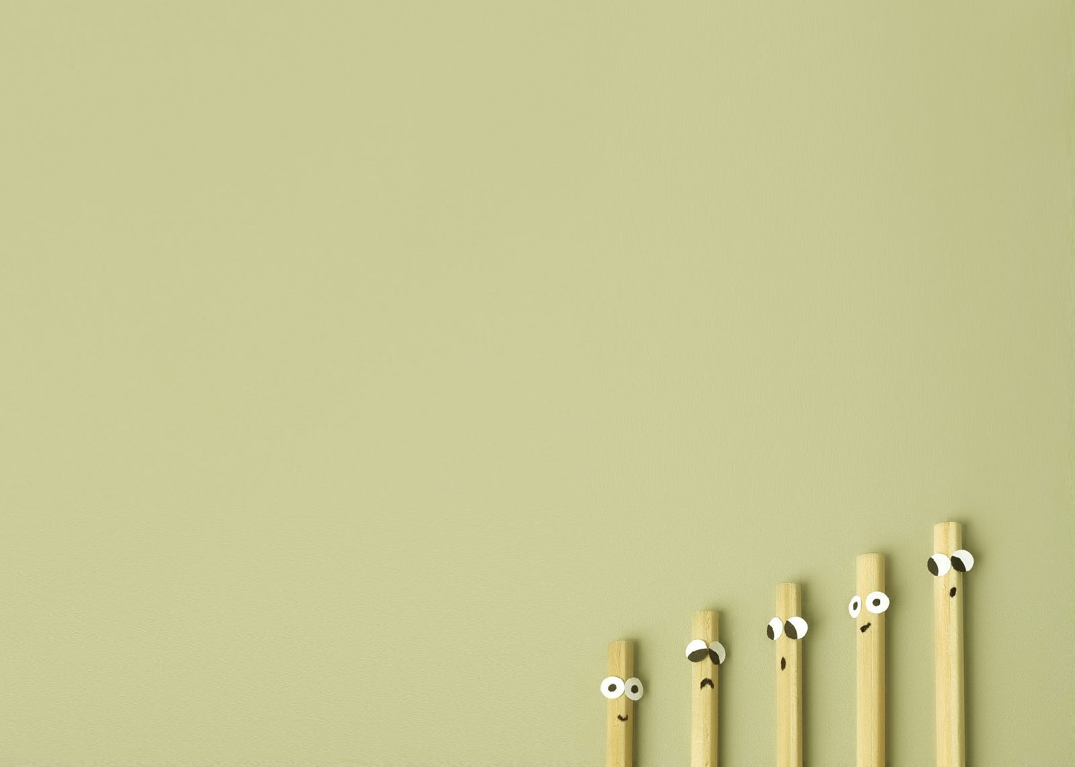
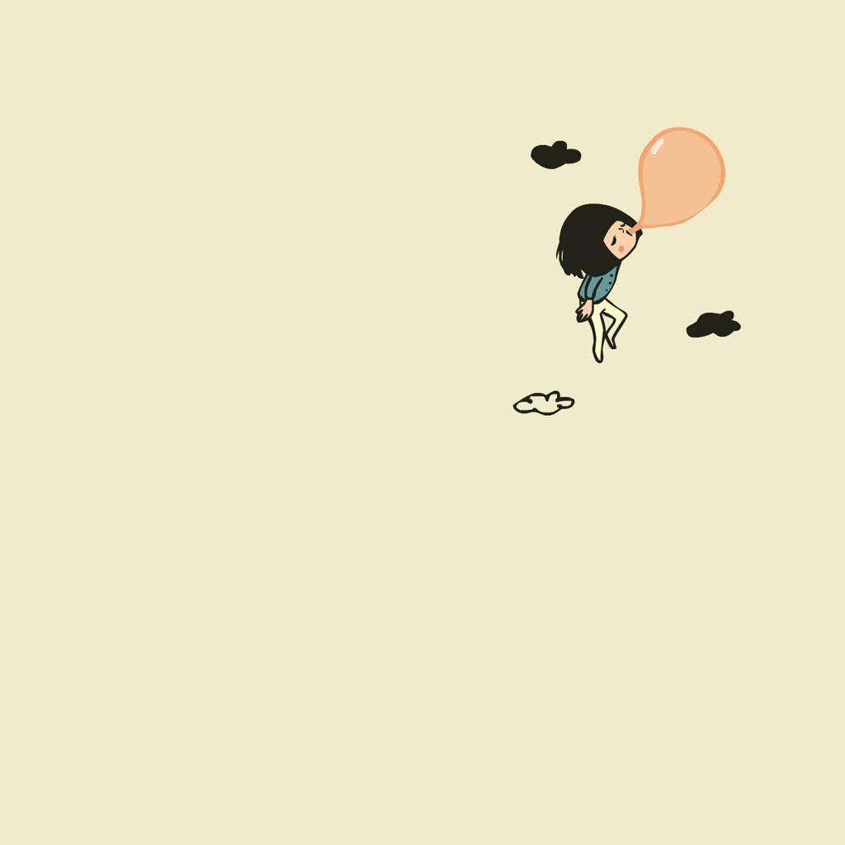
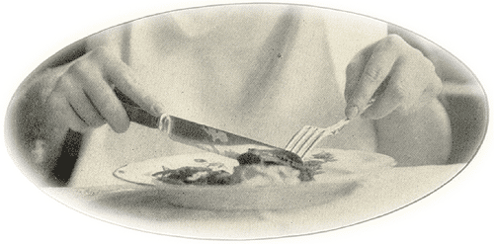
Styles of Cutting
Continental (European)
Knife in right hand
Fork in left hand
Tines of fork remain down
Knife used for cutting and pushing food onto fork

Slide 43
American
Knife held in right hand to cut
Place knife down and put fork in right hand to bring food to mouth
Tines of fork are up
Americans only people to eat this way

Slide 44
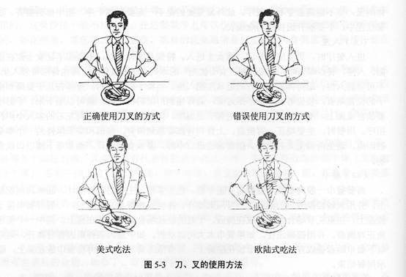

Slide 45
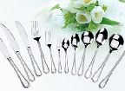
Use of Tableware

Slide 46
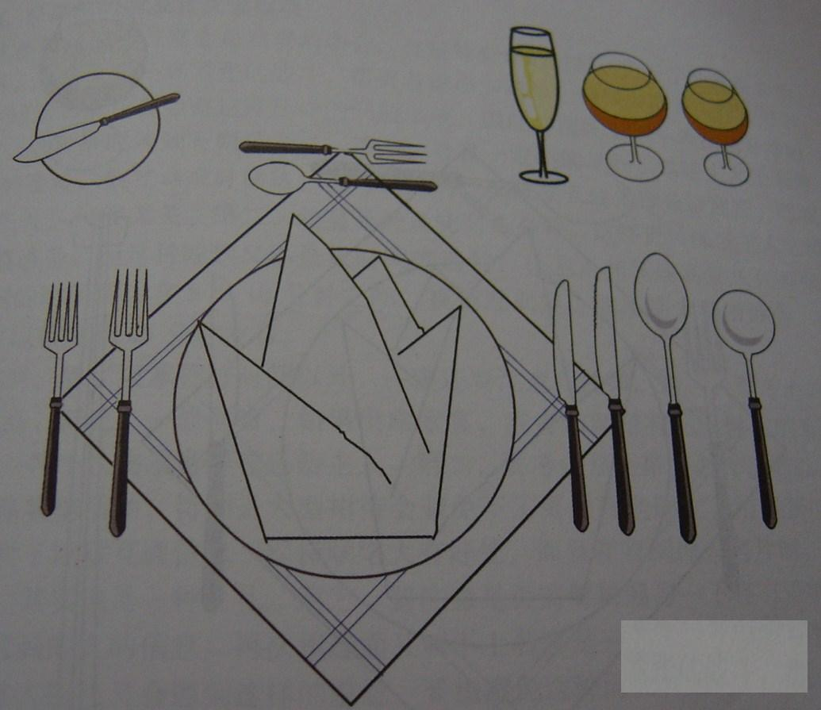
Knives：
Steak knife
Dinner knife Butter knife
Forks：
Salad fork Dinner fork Fruit fork
Spoons：
Soup spoon
Dinner spoon
Dessert spoon
The table Setting

Slide 47
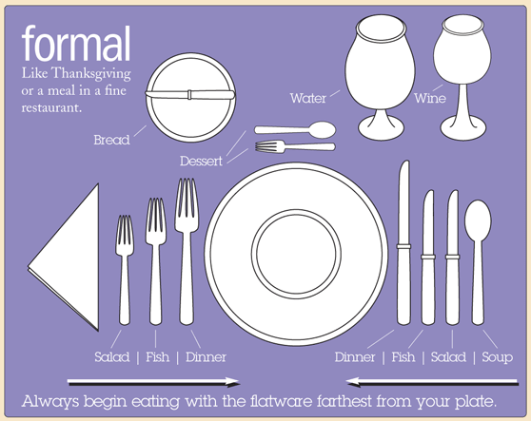
A Typical Table Setting

Slide 48
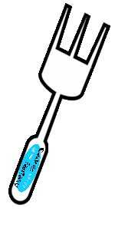
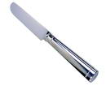
吃到一半，中间休息时刀叉应如何摆放？
餐盘
餐桌
餐盘

Slide 49
吃完餐后刀叉应如何摆放？
餐盘
餐盘

Slide 50
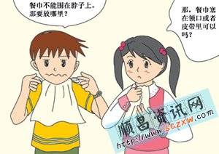
Napkins

Slide 51
Napkins
The napkin should be placed on the thigh.
Napkin laid neatly on the back of your chair
----“I will be right back.”
Napkin folded and placed to the left of your plate
---- “I am finished.”

Slide 52
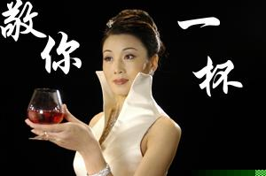
酒具与品酒

Slide 53
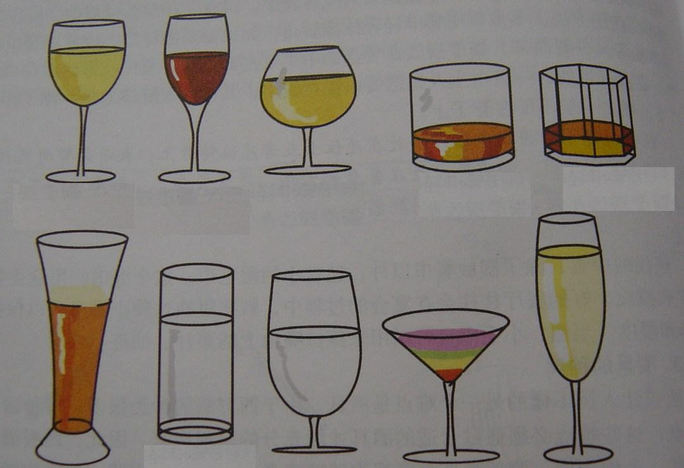
白葡萄酒、水杯、威士忌、鸡尾酒、白兰地
甜酒、 冰激凌、红葡萄酒、香槟、啤酒
(1)白葡萄、 (2)红葡萄、(3)白兰地、(4)威士忌、(5)啤酒、(6)鸡尾酒、(7)水杯、(8)甜酒、(9)冰激凌、(10)香槟
1
2
3
4
5
6
7
8
9
10

Slide 54
1.汽酒： （礼仪酒）香槟。
2.葡萄酒：
配餐原则：红酒配红肉，
白酒配白肉；
味浓（红），
味淡（白）；
持杯
红葡萄酒

Slide 55
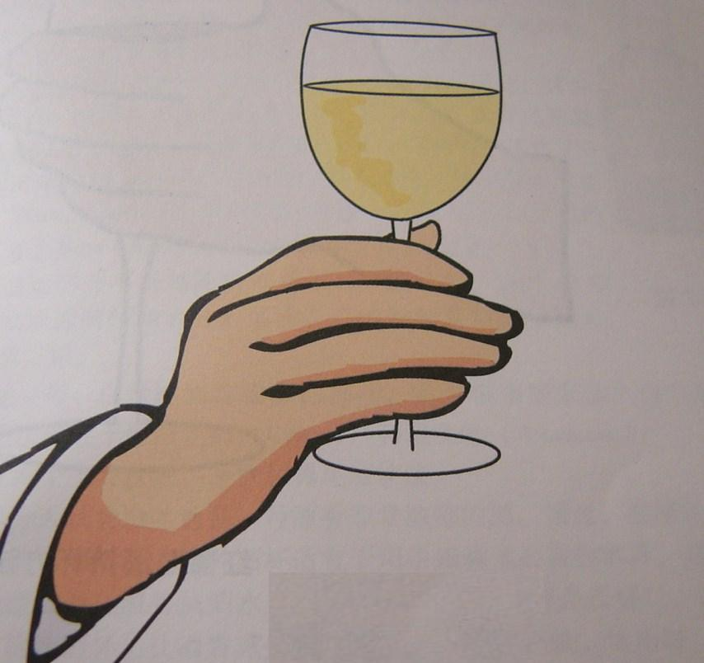
white wine

Slide 56
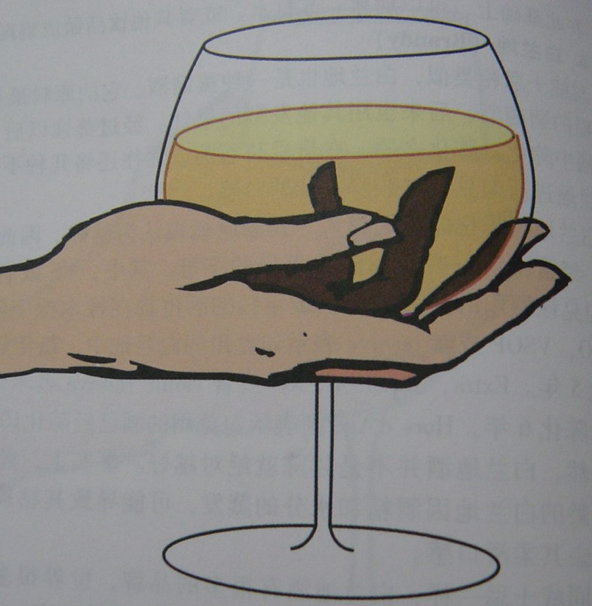
Brandy

Slide 57
Seating Arrangement

Slide 58
Seating Arrangement
（1）Seat of honor 尊位
（2） Seating Arrangement 位次排序
（3） Practice in Various occasions 实践中的体现

Slide 59
尊位
尊位也叫上位，是一场活动中最重要、最尊贵的位置。这种位置既可以是座位，也可以是站位、行位。
尊位的三个特征：
1）应是居中心意义的位置。
2）应具有视野上的最佳位置。
3）应具有行动上的最便利的条件。
中国：以左为贵
西方：右贵左贱

Slide 60
尊 位

Slide 61
尊位的确定和位次排序原则
以“门”作为确定尊位的参照物
原则： “尊位居中”
“先右后左”
“按职排位”

Slide 62
位次及其排序
1. the order of precedence 位次排序
在正式的国际政务和商务活动中，位次排序主要是根据利益关系而定。
2.位次排序原则
（1）主客双方对等原则
相同或相似职位的对等排序

Slide 63
主客交叉排序
主客平行排序
红星代表主方，蓝星代表客方

Slide 64
（2）职位排序原则
女士优先，资历优先。
商务活动中，按职位排位是一个突出特点。
（3）利益排序原则
商务活动中主客双方往往会涉及到社会各方面。单纯“按职位排位”行不通时，需要考虑按利益关系排序。
（4）荣誉特例原则
（5）按姓名的字母或笔画来排序

Slide 65
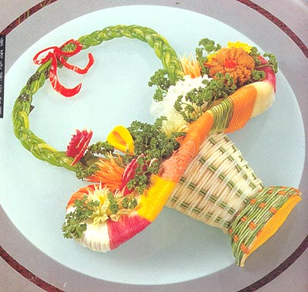
实践中位次排序和尊位的体现
1. 商务宴请中的尊位确定和位次排序
桌次排序： 只在两桌以上方用到
座次排序：每场活动中都会涉及到

Slide 66
桌次排序（1） ： 箭头型排序法
4
2
1
5
3
门
“先右后左”

Slide 67
桌次排序（2） ：挑担型排位法
1
2
3
7
5
4
6
8
“先右后左，先里后外”

Slide 68
桌次排序（3）： 两桌左右型排位法
判断左右：应面门而立
1
2

Slide 69
桌次排序（4）： 两桌上下型排位法
1
餐桌与门成一直线时，靠门远的为主桌
2
门

Slide 70
1
1
1
2
2
2
3
门
门
门
两桌横排
两桌竖排
三桌竖排
4
5
1
2
1
3
2
3
2
1
3
4
5
5
4
6
6
7
门
门
门
五桌竖排
六桌横排
七桌横排
桌次排列

Slide 71
Seating arrangement 座位安排
The French Method of Seat Arrangement
The British Method of Seat Arrangement
Host
Next Most IMP. Female Guest
Most IMP. Female Guest
Most IMP. Female Guest
Next Most IMP. Female Guest
Host
Hostess
Dinner Table
Dinner Table
Most IMP. Male Guest
Next Most IMP. Male Guest
Next Most IMP. Male Guest
Most IMP. Male Guest
Hostess

Slide 72
The Chinese Method of Seat Arrangement
Most IMP. Guest
Next Least IMP. Guest
Host
Dinner Table
Hostess
Least IMP. Guest
Next Most IMP. Guest

Slide 73
位次排列
席位高低以离主人的座位远近而定。
主位
主位
1
1
2
2
3
5
6
4
5
8
7
6
7
8
4
3
9
主二位
一个主位时的位次排列
二个主位时的位次排列

Slide 74
2. 商务会谈中的尊位确定和位次排序
原则： “尊位居中”
“先右后左”
“按职排位”

Slide 75
商务会谈中的尊位确定和位次排序
客方
低职
高职
客尊
主尊
门
低职
高职
主方
客尊，主尊
客方，主方
低职，高职
客尊
主尊
尊位也可在此

Slide 76
方案一
会
议
桌
主
方
人
员
客
方
人
员
方案二
门
会
议
桌
客
方
人
员
主
方
人
员
门

Slide 77
主
一
号
主
五
号
主
三
号
主
二
号
主
四
号
主方人员
此处可安排译员
客
一
号
客
二号
或译
员
客
四
号
客
五
号
客
三
号
客方人员

Slide 78
方案一
方案二
靠出入口来确定。面朝出入口的中央位置可作尊位
靠主桌的位置来确定。一般至少有两张桌以上的席位。主桌上、面向其它桌的中央位置可作尊位

Slide 79
3. 商务迎送活动中的尊位及位次排序
1)汽车里
尊位的确定主要根据司机的身份而定。
A. 司机为专业司机
B. 司机为主人

Slide 80
A：
3号
1号主宾
4号
2号主人
驾驶员

Slide 81
B：
1号主宾
2号
4号
3号
驾驶员为主人

Slide 82
2）迎宾线、送宾线
迎宾线：即迎接贵宾时，为表示隆重之意，同时便于主客双方相互致意而由主方人员列队组成的一条欢迎线。
送宾线：即为欢送贵宾时的一条送别线。
排列方式：主要有“南分雁”和“领头羊”型。

Slide 83
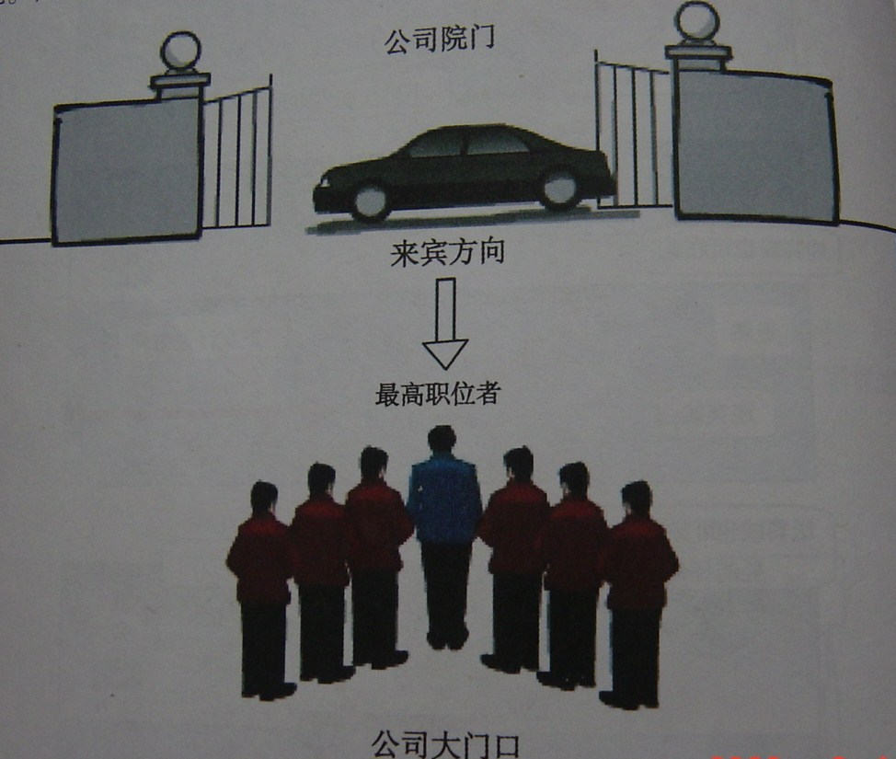
南
分
雁
型

Slide 84
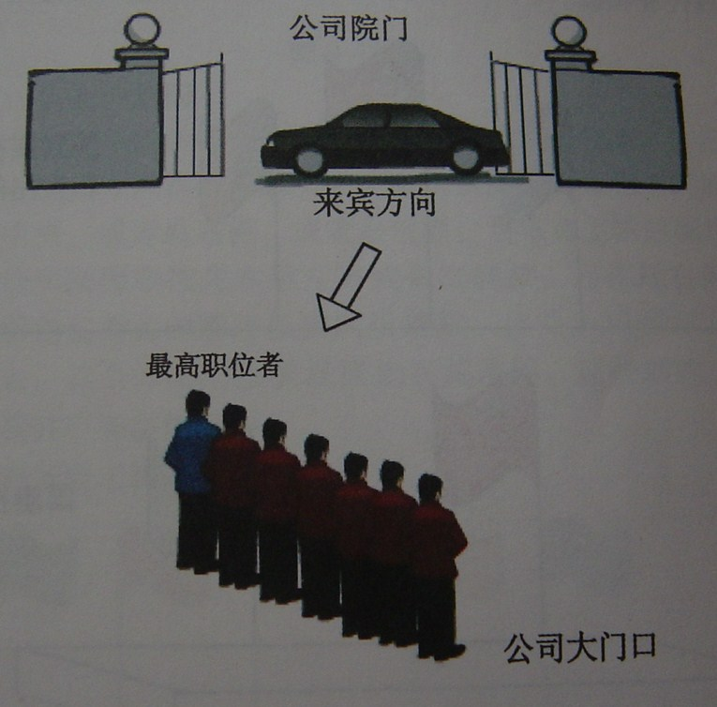
领
头
羊
型
迎宾线一般面朝迎客方向；送宾线的队尾一般指向出口”型

Slide 85
会谈室
会谈桌
A
C
迎宾线亦可在此
B
D
入 口
迎宾线
走 廊
贵宾行进方向

Slide 86
宴会厅
A
B
迎宾线亦可在此
D
C
门
走 廊
贵宾行进方向
迎宾线

Slide 87
贵宾行进方向
宴会厅
C
A
送宾线亦可在此
B
D
门
送宾线

Slide 88
Unsuitable items for gifts in the international business activities
1. Knife.
Except the gift knife with national characteristics and the Swiss army knife.
2. The clock and shoes.
3. The drug.
4. Animals and plants live.
5. Fresh food of plant and animal, plant seeds.

Slide 89
Different ways of sending gifts
Chinese | Westerners
Expensive gifts are welcome.
Expensive gifts are not expected.
Fruit is a common one to bring with when visiting a family.
Gifts or fruit are thought of as only appropriate of visits to the people who are ill.
Numbers of gifts suggest good luck. So one bottle of wine is unusual.
One bottle of wine is quite enough , two are also welcome but unusual and not

Slide 90
Different ways of receiving gifts
Chinese | Westerners
Tend to open the gifts after the visitors have left. | It is regarded as polite to open gifts as soon as they are given to express appreciation. It is impolite to just say thank you and put the gift away in a corner.

Slide 91
Dressing

Slide 92
Dressing Rules 着装礼节
Not following the 11-inch rule when wearing a skirt.
Believing that permanent press clothes do not have to be ironed.
Not investing in the same quality of business casual garments as when buying business professional attire.
Assuming that "mules" are business casual shoes.
Not wearing clothes that can take you into any meeting on a moment's notice.
Dressing for the job you have rather than the one you want.
Not wearing the same quality accessories on business casual days that you do when dressed professionally.
Wearing flowery prints and gingham checks.
conform to local customs concerning appropriate attire.

Slide 93
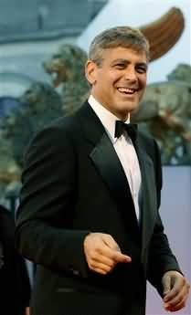
3.2 Keeping it simple
A well-fitted dark suit—usually blue, gray, or black—is appropriate for almost all formal business situations and most social occasions.

Slide 94
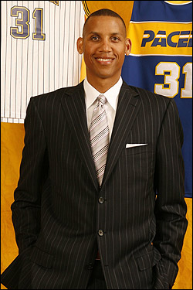
Even at more casual social affairs, being dressed smartly pays dividends. The rule of thumb (经验之谈): when in doubt, overdress for the occasion.

Slide 95
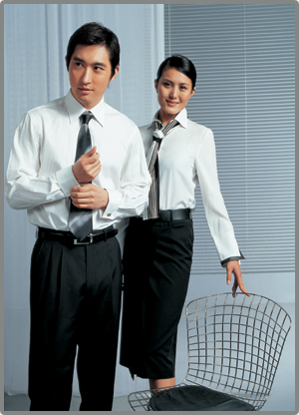
A light-colored dress shirt—the best color is white--and a tie are standard. Though most such cultures are not fanatical about it, long-sleeve shirts are preferred. Short sleeves are OK for after work casual meetings.

Slide 96
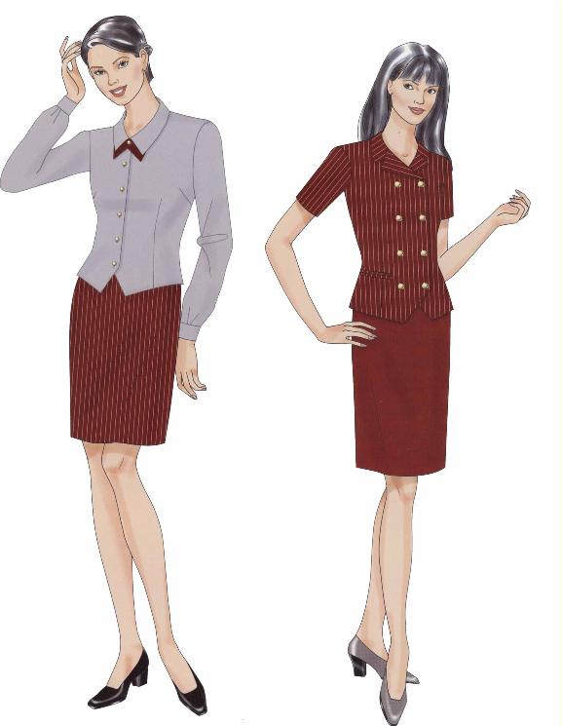
3.3 Dressing for women
For women, skirts and dresses are more the norm than pants in most every part of the world

Slide 97
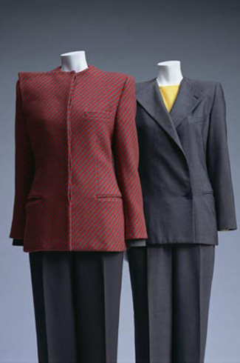
For women, power dressing may in fact make it harder to break down the stereotype of businesswomen as pretenders to male power.

Slide 98
视觉美学在商务活动中的运用
视觉美的运用
视觉“美”体现在国际商务礼仪实践的方方面面：着装、仪容、礼品、环境、企业的标志、商品外观、广告的创意、公文用纸等。
形状和色彩是构成我们视觉的两根支柱。
点和线是形状的基本要素。

Slide 99
视觉美的运用
点的运用
点具有聚集视觉感受的效果，容易形成视觉的焦点。要想突出某个部分，最好的办法是在该部位营造一个“点’的效果。
注意：避免污点的出现

Slide 100
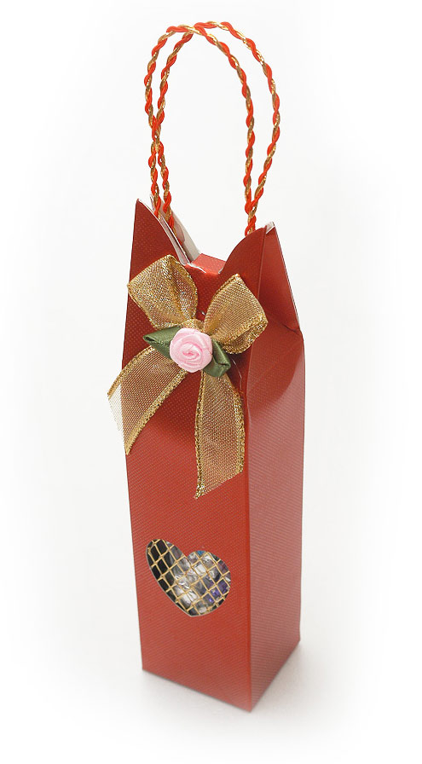
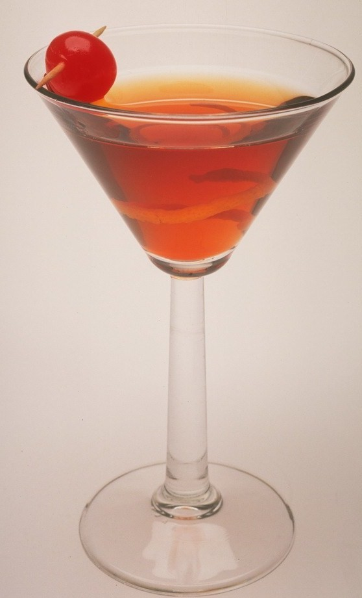
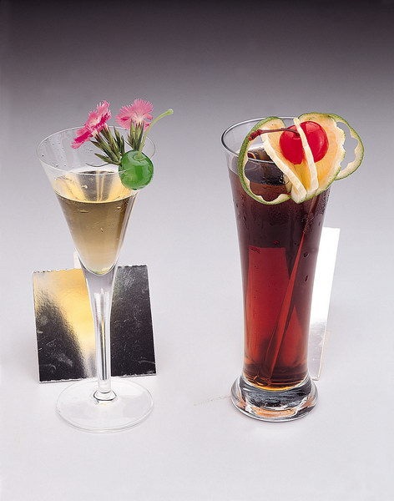
视觉美的运用

Slide 101
视觉美的运用
线的运用：
直线给人以整齐、硬朗、冷峻的感受，具有很强的“阳性”、“刚性”，是一种最适合男性的线条。同时，直线还给人保守、传统、内敛、自控的暗示。
曲线给人以凌乱、柔软、含糊、顺滑的感觉，具有一定的“阴性”，是一种适合女性的线条。同时，曲线还给人创新、外放、自由的暗示。

Slide 102
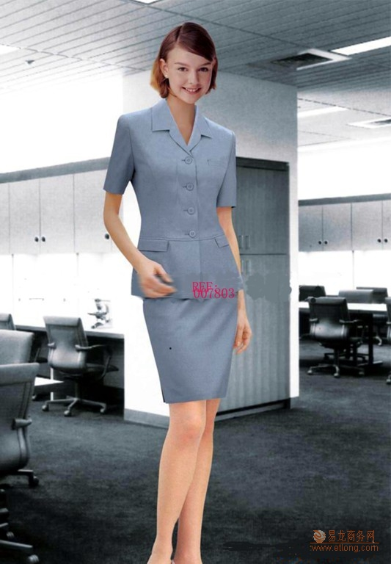
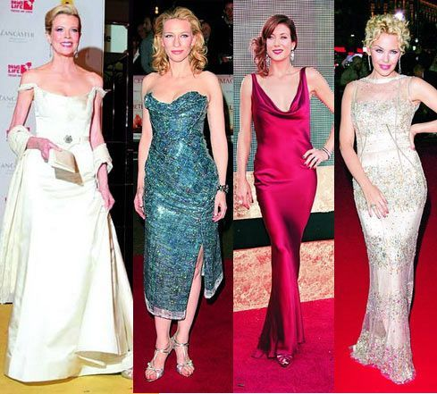

Slide 103
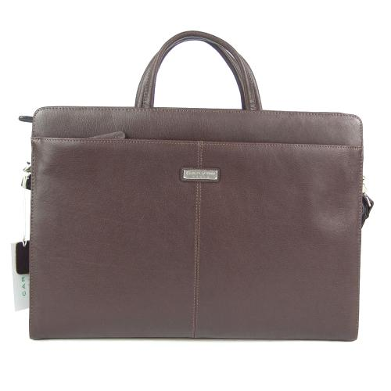
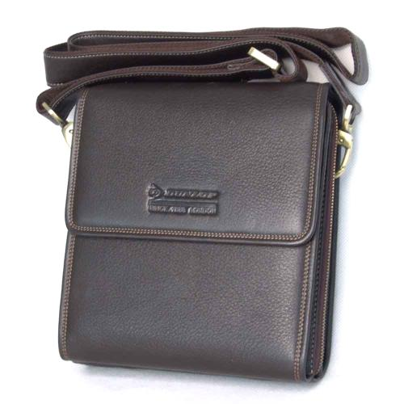

Slide 104
黄金分割点
通俗地讲，黄金分割点就在一条线的3/5处。
如：
腰带、礼品的包装、演讲台的安排、背景板上的徽标等

Slide 106
Global Dress Codes
People communicate through what they wear, their hairstyle, and the polish of their shoes and even the look of their fingernails.

Slide 107
An expensive watch is usually noticed and is considered a subtle symbol of success and prosperity in just about every culture doing international business.

Slide 108
“Formal Dress，Black Tie”

Slide 109
The principle of dress in international business activities
1） TPO 原则
Time, Place, Occasion
2）盛装原则
“Over dress is always better than down dress.”
3）统一原则
主要指服装类型的统一，每一类的服装应与同类服装搭配。同时，还应注意服装各部分之间款式、服装与配件之间款式的统一和协调。

Slide 110
Social Customs

Slide 111
V. Social Customs 社会习俗
Punctuality
superstition

Slide 112
Comprehension Questions
Do you know any superstition in other cultures?
2. Do you know any taboo in Chinese culture? Or any taboo
in other cultures?
3. Do you think it is acceptable to use humorduring business
meeting? Why?

Slide 113
Activities:
Task 1
What would you do if you met women and you didn’t know if she should be called “Mrs.”, “Miss” or “Ms.”?
You could use “Ms.”
You could try not to use her name.
You could check the women’s left hand to see if she’s married.
Can you think of anything else you could do?
Task 2
What would you do if you were introduced to someone and you didn’t know whether or not to shake hands?
a).You could keep your hands in your pockets in order to avoid shaking hands.
b).You could wait and see what the other person does and then you could do the same.
c) You could be the first person to give your hand.

Slide 114
Activities:
Task 3
Research superstitions of a country of your choice and make an oral report to the class.
Task 4
Role play: Mike is a human resources manager of an international company. He is assigned to arrange a dinner party for the whole company. Since the employees are coming from all over the world, what cultural differences concerning dinning and drinking should he take into consideration? If you were him, how will you arrange this dinner party including questions like when, where and what to eat?

Slide 115
Case Analysis
Case 1
Your organization is having a large party for its worldwide distributors in the United States. Since there will be people from all over the world, what would you serve for meals to avoid offending anyone?

Slide 116
Case Analysis Case 2
Professor Smith and his assistant, Ming Chen, were doing fieldwork in a small city in China. It was hot and humid, and both were casually dressed. One night as they were leaving for dinner, a local administrator told them that the mayor of the city, who was interested in the type of research they were doing, would like to say hello to Professor Smith. And the mayor was dining in the same restaurant as Smith and Ming Chen.
Professor Smith said he had to go back to his room to change.
“You look fine. Come on, the mayor is waiting,” the administrator said.
“No, I can’t meet the mayor in my shorts.”
What do you think of Professor Smith’s response when he was told to see the mayor?

Slide 117
Case Analysis Case 3
A Japanese businessman on his first visit to the United States was pleased to be invited to a U.S. executive’s home for cocktails. He arrived promptly at 7 p.m. The host introduced him to a small group of people, and then returned to the front door to greet others who were arriving. The Japanese businessman apparently had nothing to contribute on the seemingly mindless topics that were discussed. After a few minutes, the others in the group wandered off to join other groups, and he was left alone. Since the host did not return to introduce him to others at the party, he left and returned to his hotel. What, if any, rules of proper etiquette were breached?

Slide 118
实践
每组4-6人，要求每组以平日生活为蓝本，自由编撰一个商务情景剧，在情景模拟中要运用见面、称呼、介绍、握手、交换名片、座次安排等交际的礼仪规范，并注意展现自身良好的仪容、仪表、仪态。

Slide 119
Thank you!

